Slide 1
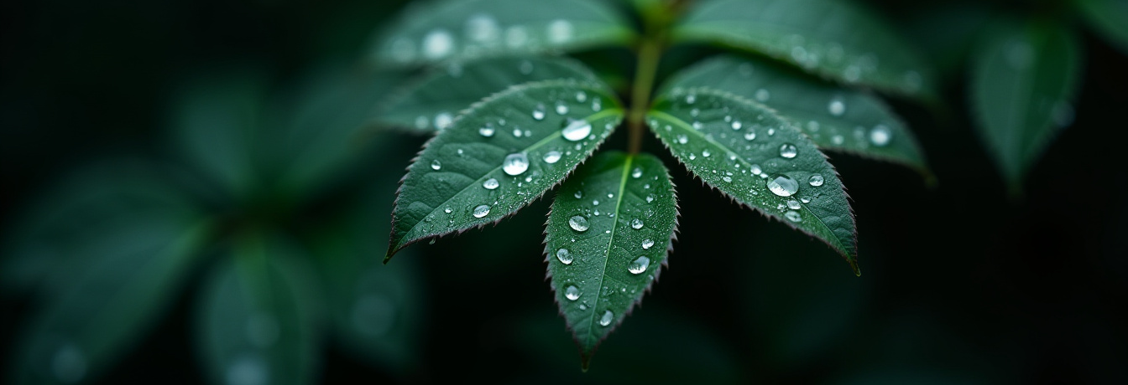
NATURE
STYLE
Here is where your
presentation begins

Slide 2
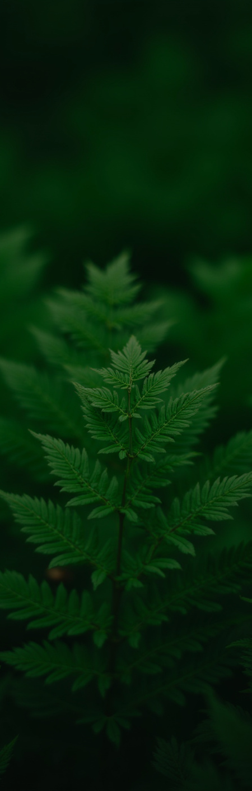
CONTENTS OF THIS TEMPLATE
You can delete this slide when you’re done editing the presentation
Fonts | To view this template correctly in PowerPoint, download and install the fonts we used
Used and alternative resources | An assortment of graphic resources that are suitable for use in this presentation
Thanks slide | You must keep it so that proper credits for our design are given
Colors | All the colors used in this presentation
Icons and infographic resources | These can be used in the template, and their size and color can be edited
Editable presentation theme | You can edit the master slides easily. For more info, click here
For more info:
SLIDESGO | SLIDESGO AI TOOLS | BLOG | FAQs
You can visit our sister projects:
FREEPIK AI TOOLS | FREEPIK LIBRARY RESOURCES

Slide 3
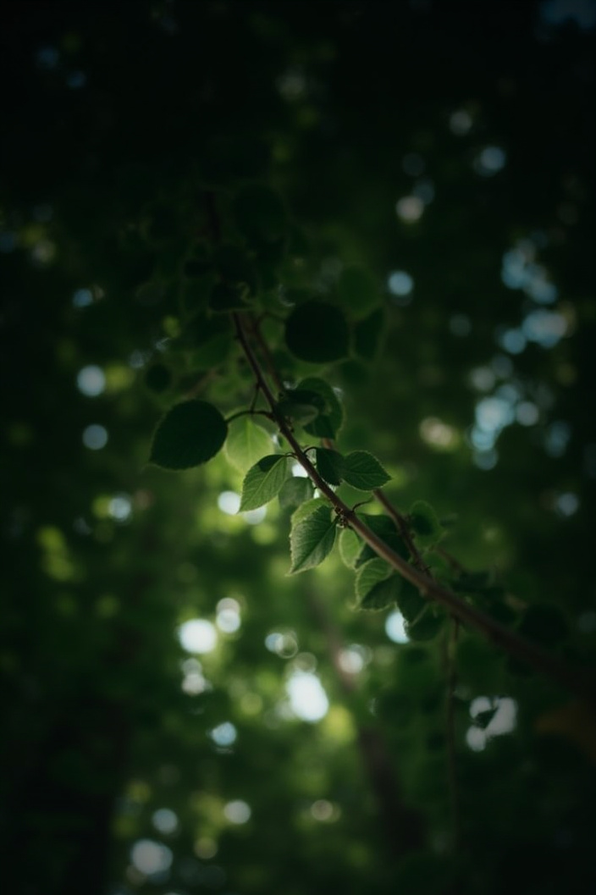
TABLE OF CONTENTS
01
02
03
SECTION NAME
You can describe the topic of the section here
SECTION NAME
You can describe the topic of the section here
SECTION NAME
You can describe the topic of the section here

Slide 4
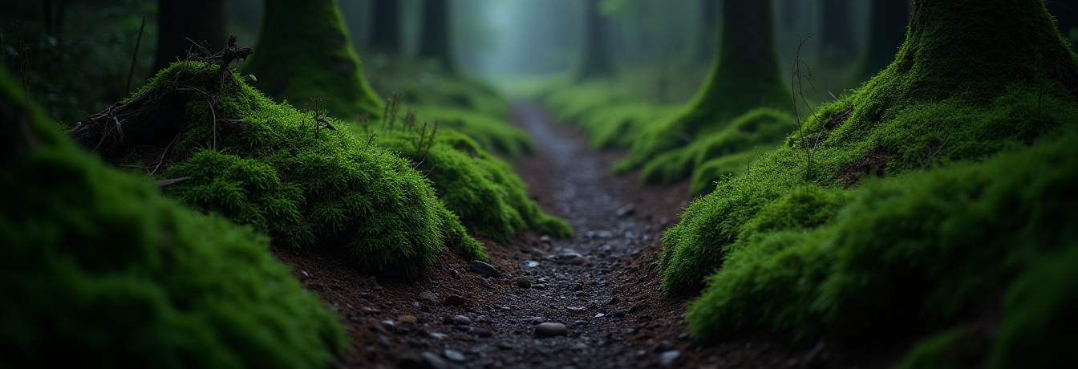
SECTION NAME
01
You can enter a subtitle here if you need it

Slide 5
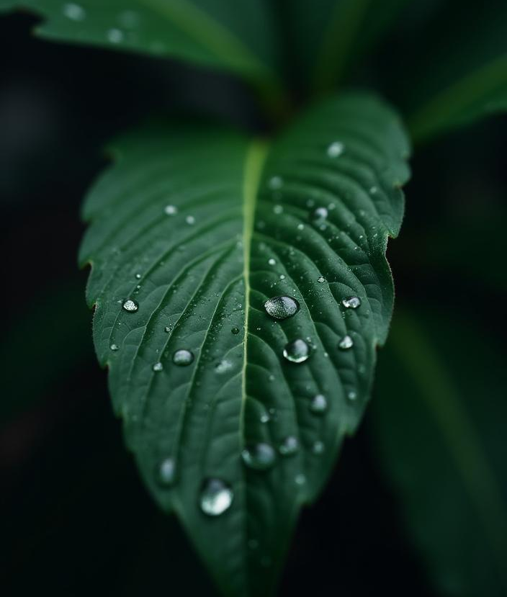
THE SLIDE TITLE GOES HERE!
Do you know what helps you make your point clear?
Lists like this one:
They’re simple
You can organize your ideas clearly
You’ll never forget to buy milk!
You can replace the image. Just right-click on it and select “Replace image”

Slide 6
LET’S HAVE A LOOK
Mercury is the closest planet to the Sun and the smallest one in the entire Solar System. This planet’s name has nothing to do with the liquid metal, since Mercury was named after the Roman messenger god. Despite being closer to the Sun than Venus, its temperatures aren't as terribly hot as that planet’s. Its surface is quite similar to that of Earth’s Moon, which means there are a lot of craters and plains. Speaking of craters, many of them were named after artists or authors who made significant contributions to their respective fields. Mercury takes a little more than 58 days to complete its rotation, so try to imagine how long days must be there!

Slide 7
TWO IDEAS
MERCURY
Mercury is the closest planet to the Sun and the smallest one in the Solar System. This planet’s name has nothing to do with the liquid metal
VENUS
Venus has a beautiful name and is the second planet from the Sun. It’s hot and is the second-brightest natural object in the night sky

Slide 8
THREE IDEAS
MERCURY
MARS
VENUS
Mercury is the closest planet to the Sun and the smallest one in the System
Despite being red, Mars is actually a cold place. It’s full of iron oxide dust
Venus has a beautiful name and is the second planet from the Sun

Slide 9
SIX DIFFERENT IDEAS
MERCURY
VENUS
MARS
Mercury is the smallest planet in the Solar System
Venus is the second planet from the Sun
Despite being red, Mars is actually a cold place
JUPITER
SATURN
NEPTUNE
Jupiter is the biggest planet in the Solar System
Saturn is composed of hydrogen and helium
Neptune is the farthest planet from the Sun

Slide 10
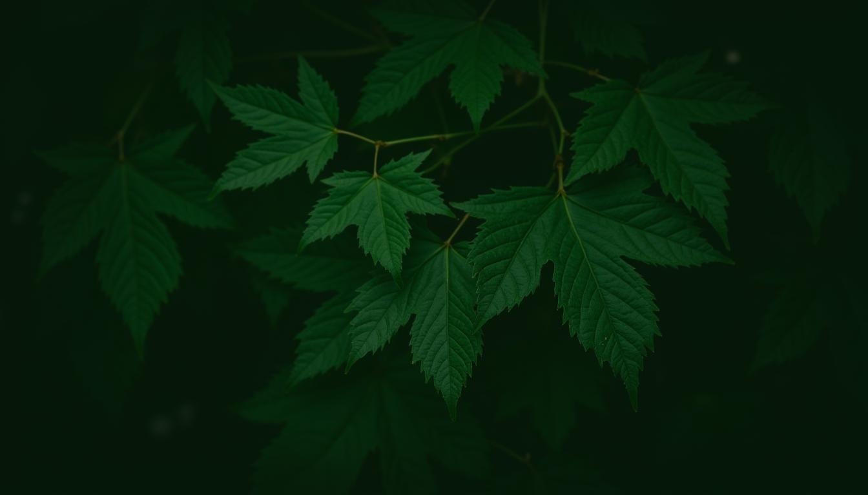
A PICTURE IS WORTH A THOUSAND WORDS

Slide 11
Our history
STEP 1
STEP 3
Mercury is the closest planet to the Sun
Despite benign red, Mars is a very cold place
STEP 2
STEP 4
Venus is the second planet from the Sun
Earth is the only one that harbors life in the System

Slide 12
YOU CAN USE AN INFOGRAPHIC
EARTH
VENUS
Earth is a planet that has life
JUPITER
Jupiter is the biggest planet
MERCURY
NEPTUNE
SATURN
Neptune is far away from Earth
MARS
Mars is full of iron oxide dust

Slide 13
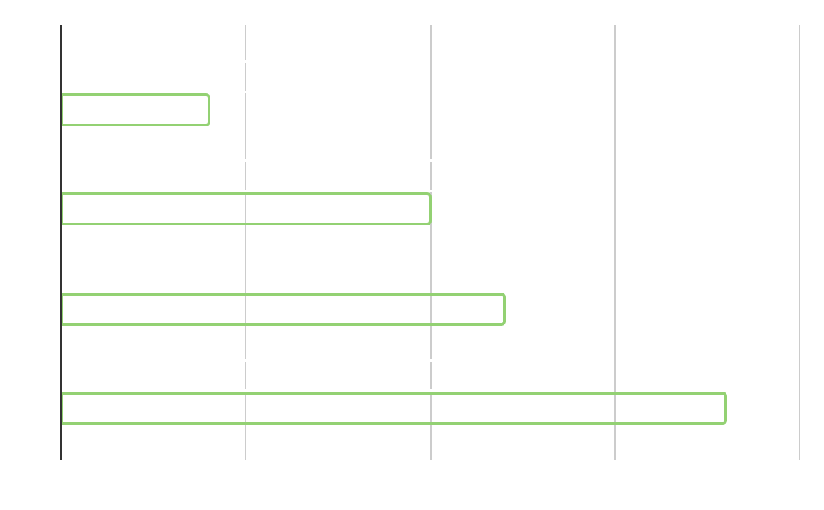
REPRESENT YOUR DATA HERE
MARS
Despite being red, Mars is actually a cold place
NEPTUNE
Neptune is the farthest planet from the Sun
MERCURY | EARTH | JUPITER
Venus | XX | XX
Mars | XX | XX
Saturn | XX | XX
Follow the link in the graph to modify its data and then paste the new one here. For more info, click here

Slide 14
333,000
386,000 km
The Sun’s mass compared to Earth’s
Distance between Earth and the Moon

Slide 15
THANKS!
Do you have any questions?
youremail@freepik.com
+34 654 321 432
yourwebsite.com
Please keep this slide for attribution

